Slide 1
Study of Relocation to the Greater Paris Area
Coursera IBM Data Science Specialization Capstone Project
May 2019

Slide 2

Introduction – BUSINESS PROBLEM
High price of accommodation in Central Paris
People seek to relocate to the Greater Paris Area
Need to relocate where living conditions are approximately similar to Central Paris
The purpose of this study is to assist people relocating to the Greater Paris area, provide them information where they can find approximately the same venues as in the city center.

Slide 3
DATA ACQUISITION
Stage 1 – Acquisition of postal codes, boroughs, neighborhoods and geographic coordinates:
For Paris: https://fr.geneawiki.com/index.php/Liste_des_quartiers_de_Paris
For suburbs: https://www.annuaire-administration.com/code-postal/region/ile-de-france.html
Stage 2 – Acquisition of venues with FourSquare

Slide 4
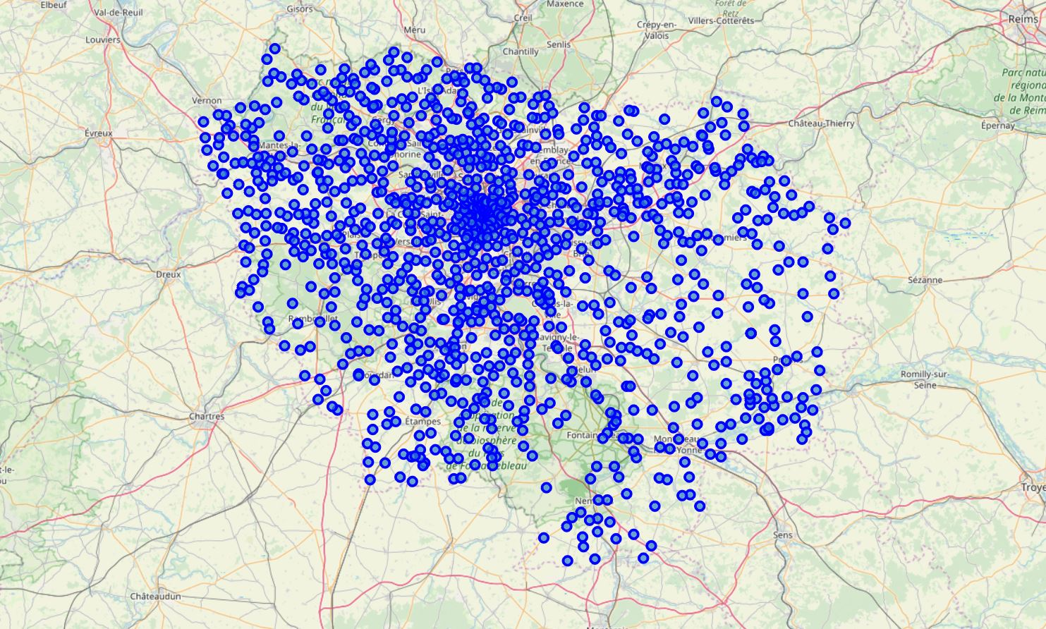
GREATER PARIS AREA NEIGHBORHOODS

Slide 5
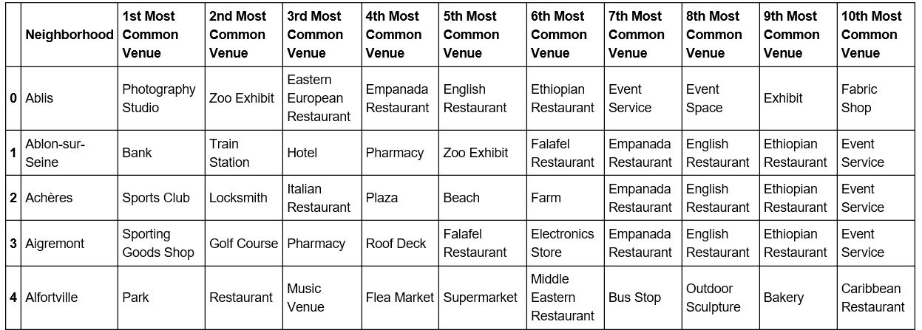
Data Analysis Methodology
Data was prepared using the following methods:
One-hot encoding of venue types in each neighborhood
Grouping rows by neighborhood and taking the mean of the frequency of occurrence of each category of venues
Putting most common venues in a Pandas data frame

Slide 6
Data Clustering INTO 8 CLUSTERS
Neighborhoods were clustered into 8 clusters based on the mean frequency of occurrence of venue types
Method of clustering: K-Means Algorithm

Slide 7
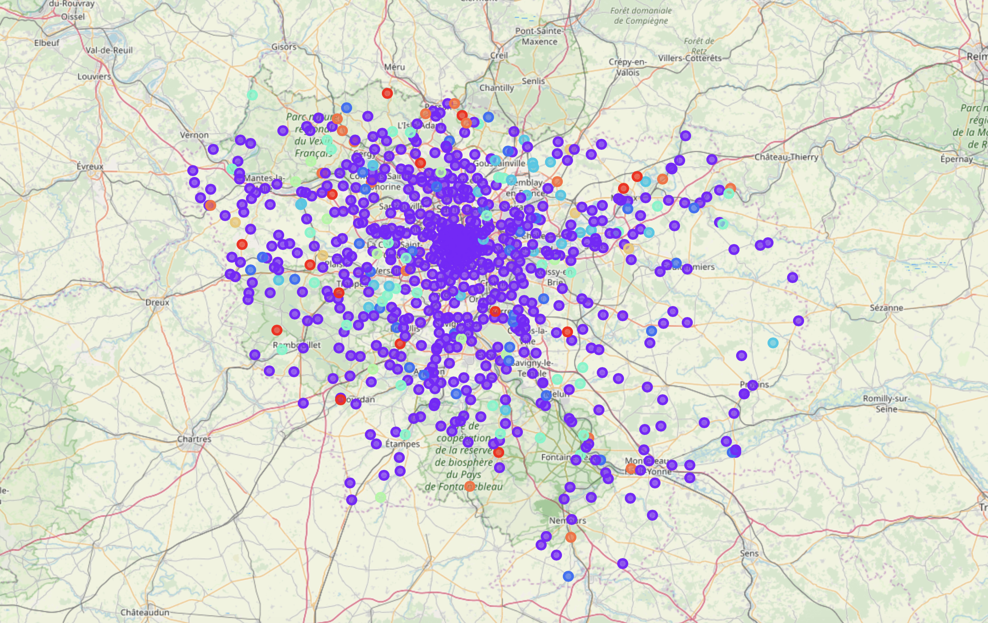
Types of venues in the Greater Paris Area

Slide 8
RESULTS – CLUSTER MEANING
Number | Title
0 | Restaurants of any type of cuisine
1 | French Restaurants and other catering facilities
2 | Supermarkets
3 | Hotels
4 | French Restaurants (related to cluster 1)
5 | Bakeries
6 | Auto Workshops
7 | Train Stations (public transport)

Slide 9
RESULTS - Cluster Comparison
Our clusters contain neighborhoods in Paris and in the Greater Paris area.
In order to guide a person when relocating, I extracted the Greater Paris neighborhoods from each cluster.
The person can find among them a neighborhood corresponding to his or her preferences based on the venues in the neighborhood this person is relocating from.

Slide 10
conclusions
This study allowed me to compare neighborhoods in Central Paris with Neighborhoods in the Greater Paris Area using venue types for comparison.
The results can be used as a guide by persons relocating from the Central Paris Area to the suburbs in order to find living conditions similar to those they used to have in the Central Paris.
Taking into account that many people are currently relocating from central city areas to the suburbs and this trend is becoming wide-spread this study can be extended to other big international cities and the areas around them.

